Slide 1
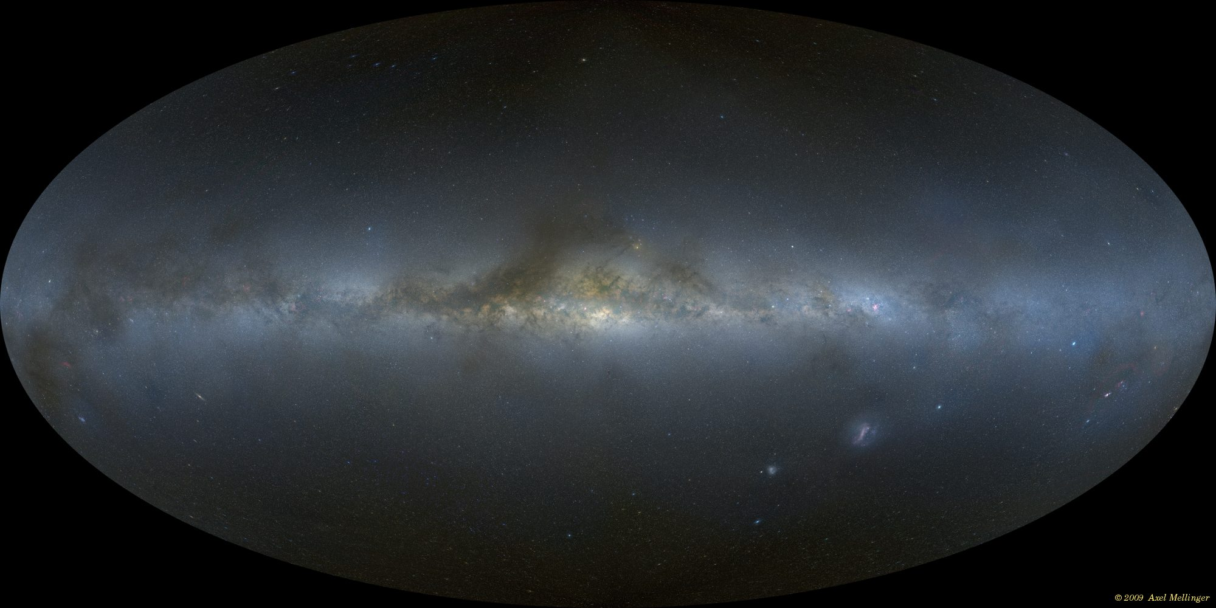
The Milky Way
dust, gas clouds
MAP OF WHOLE SKY (VISIBLE LIGHT)
Notes:
problem: how do we figure out what it is like if we are inside

Slide 2
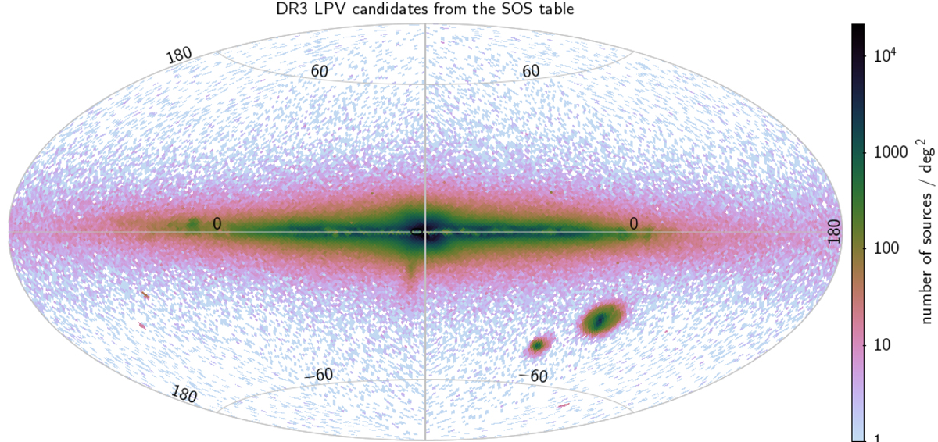
An All-Sky Map
Notes:
dimensional analysis of pressure equation / dynamical timescale

Slide 3
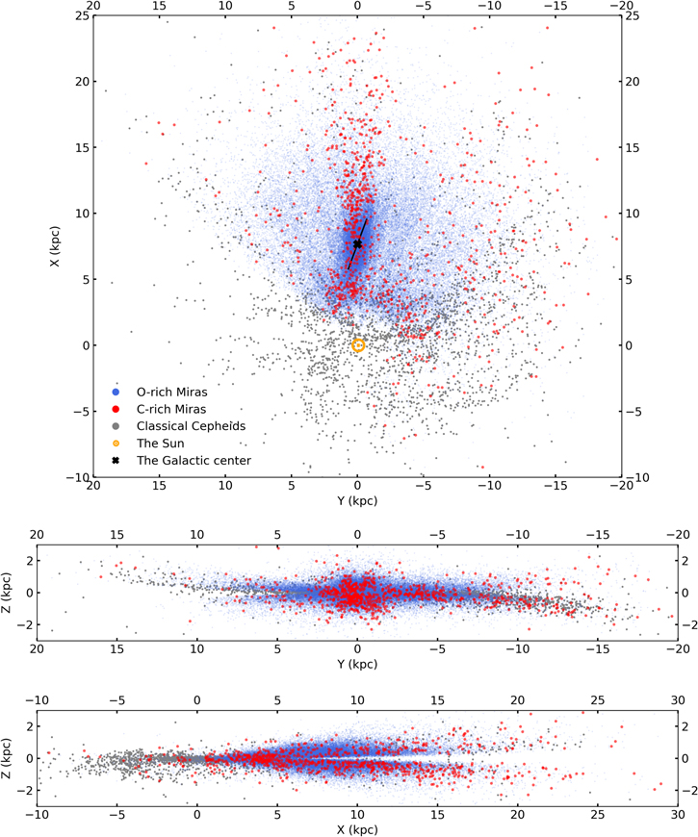
…with Distance
Notes:
dimensional analysis of pressure equation / dynamical timescale

Slide 4
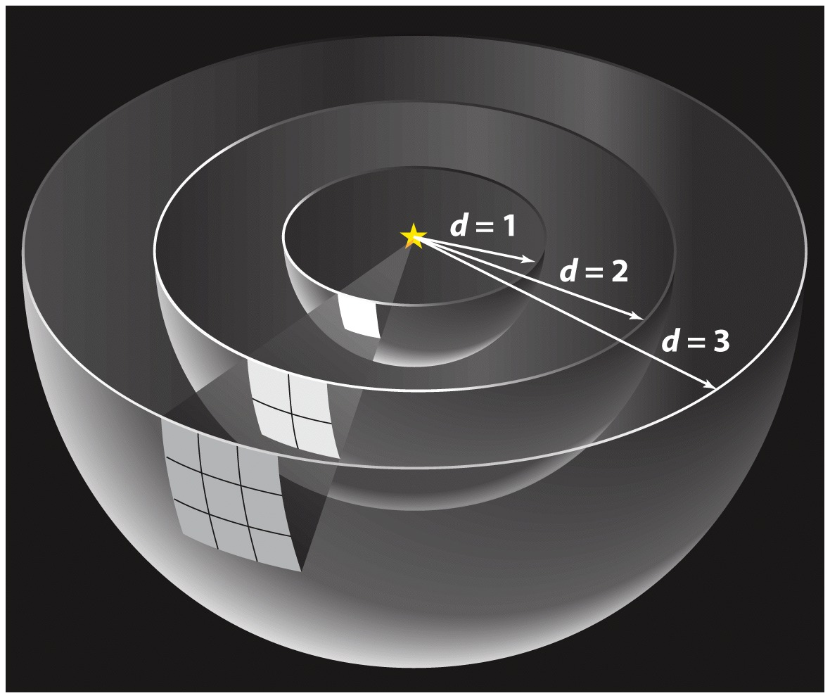
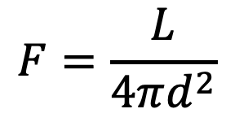
The Inverse-Square Law for Light
Light spreads out as it moves away from a source:
energy flux is energy passing through a unit area per second
$$F=\frac{L}{4πd^{2}}$$
luminosity has units of power: energy per second
Notes:
different physics from the blackbody law… don’t mix them up!

Slide 5
Discussion Question
When observing a light source, what can you do to maximize the total photons you collect?
Notes:
Answer: increase collecting area, increase exposure time, increase range of detected wavelengths
decrease distance?

Slide 6



PHOTON COUNT
PHOTON COUNT RATE
PHOTON FLUX
SPECIFIC PHOTON FLUX
number
$$\frac{\text{number}}{\text{time}}$$
$$\frac{\text{number}}{\text{area}∙\text{time}}$$
$$\frac{\text{number}}{\text{area}∙\text{time}∙\text{wavelength}}$$
Notes:
calculating flux from photon count / collecting area / exposure time
photon count
photon count rate
photon flux

Slide 7
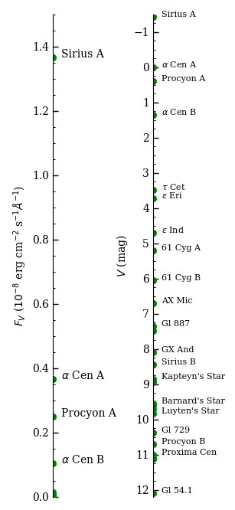

Brightness Scales
LINEAR
LOGARITHMIC
for 25 nearest stars
approximate limit for eye
MAGNITUDE DEFINITION:
$$m_{1}−m_{2}=−2.5\log_{10}\left(\frac{F_{1}}{F_{2}}\right)$$
Notes:
Linear scale makes it hard to compare objects with very different brightness levels:
Large photon count for Sirius could still leave fainter star with almost nothing

Slide 8



More Magnitudes
$$m_{1}−m_{2}=−2.5\log_{10}\left(\frac{F_{1}}{F_{2}}\right)$$
APPARENT MAGNITUDES:
based on measured fluxes in same wavelengths
ABSOLUTE MAGNITUDE: magnitude if star at a standard 10 pc distance
➔absolute bolometric magnitude relates to luminosity
$$M_{bol}=4.74−2.5\log_{10}\left(\frac{L}{L_{⊙}}\right)$$
$$m−M=5\log_{10}\left(\frac{d}{10 \text{pc}}\right)$$
DISTANCE MODULUS:
➔logarithmic code for distance
Notes:
Short derivations

Slide 9

More Magnitudes
$$m_{1}−m_{2}=−2.5\log_{10}\left(\frac{F_{1}}{F_{2}}\right)$$
APPARENT MAGNITUDES:
based on measured fluxes in same wavelengths
Notes:
Short derivations

Slide 10

Thought Question
If star 1 has a magnitude 7.5 mag smaller than star 2, what is the ratio of their fluxes (F₁/F₂)?
10⁴
1000
100
10
0.1
0.01
0.001
$$m_{1}−m_{2}=−2.5\log_{10}\left(\frac{F_{1}}{F_{2}}\right)$$
Notes:
Answer: 2 ()

Slide 11
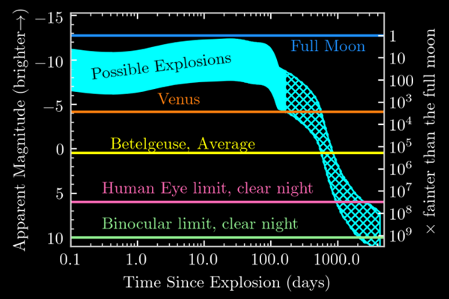
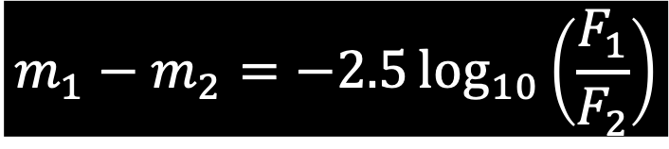
Thought Question
When Betelgeuse explodes, it may reach a peak magnitude about 12.5 magnitudes brighter. What factor brighter is this?
$$m_{1}−m_{2}=−2.5\log_{10}\left(\frac{F_{1}}{F_{2}}\right)$$
Notes:
Answer: 10^5 ()

Slide 12
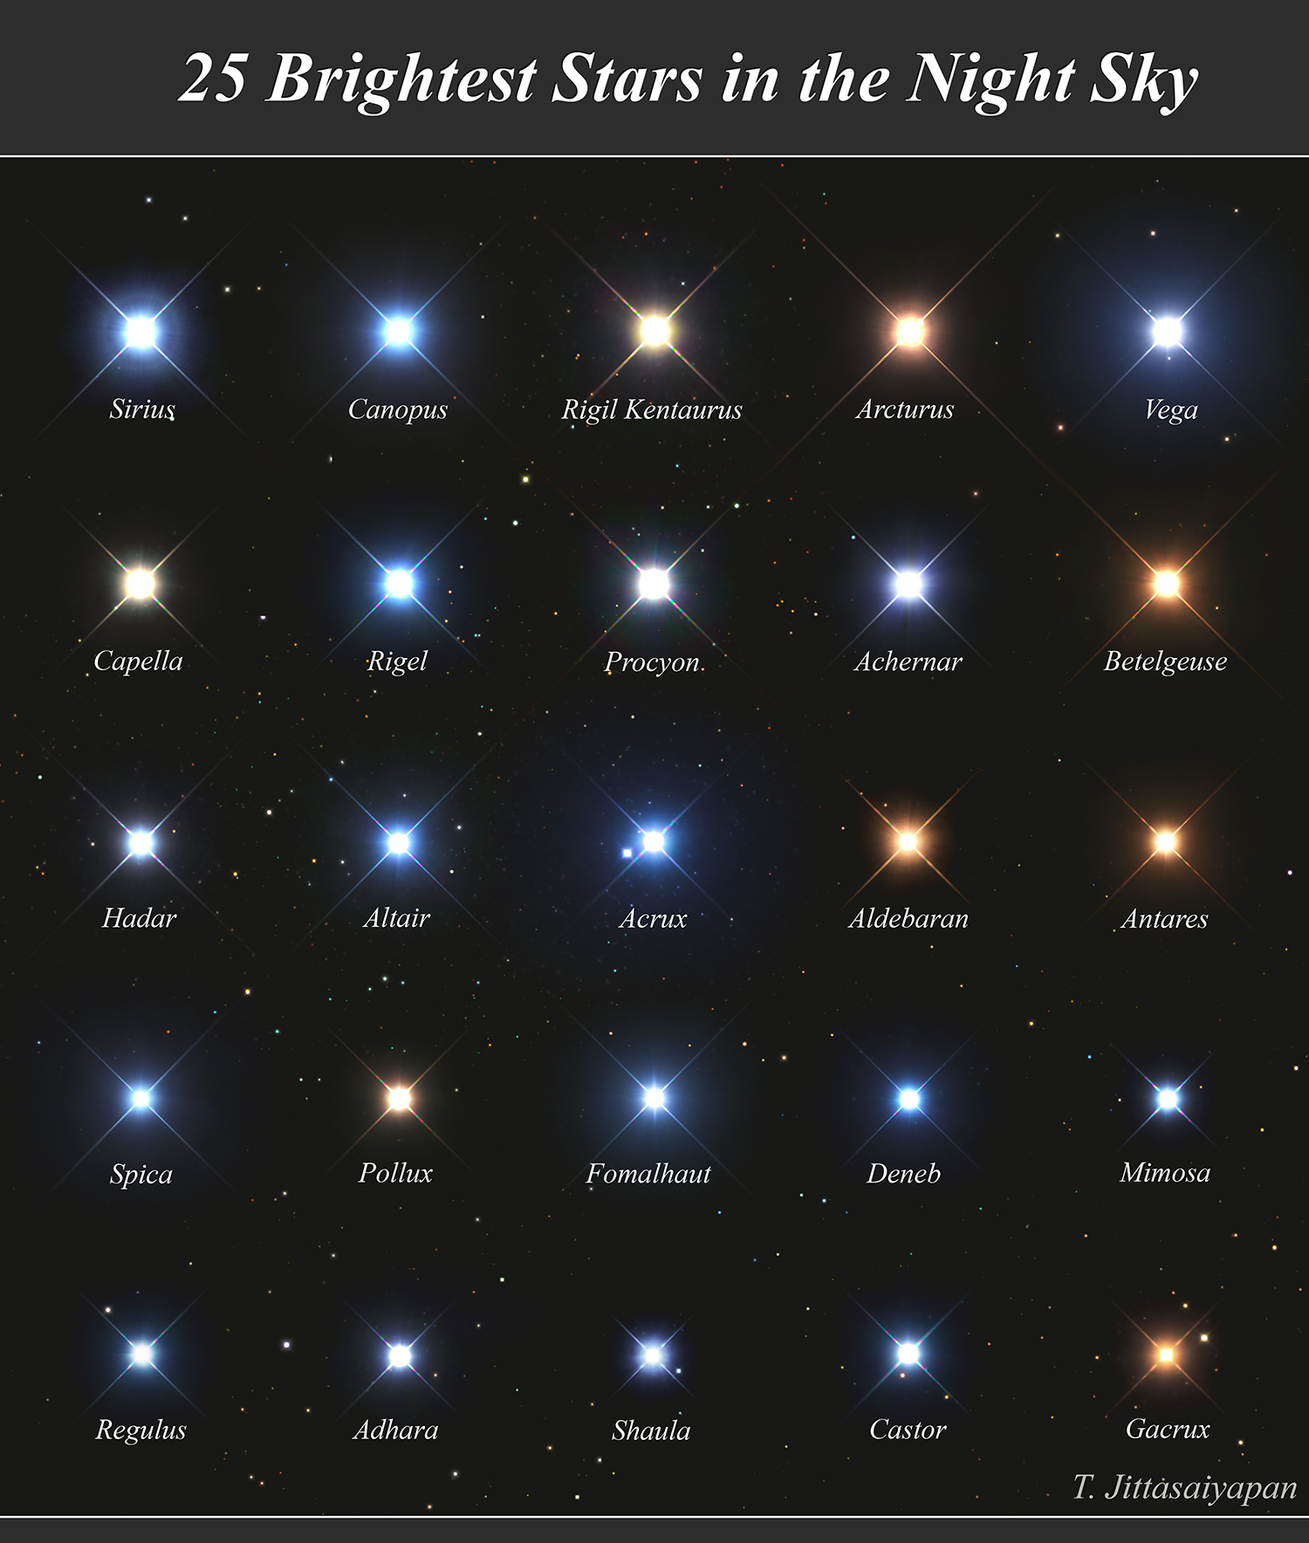
Starlight
and Color

Slide 13



Thermal Radiation Laws
…refer to light energy leaving a surface with temperature T
Wien’s Law: most intense light occurs at wavelength:
Stefan-Boltzmann Law: energy flux from surface of hot object
$$λ_{peak}≈\frac{\left(2.9×{10}^{6} \text{nm}∙\text{K}\right)}{T}$$
$$\frac{λ_{peak}}{500 \text{nm}}≈\frac{\left(5800 \text{K}\right)}{T}$$
$$F_{surf}=σT^{4}$$
10⁵ K
5800 K
2800 K

Slide 14
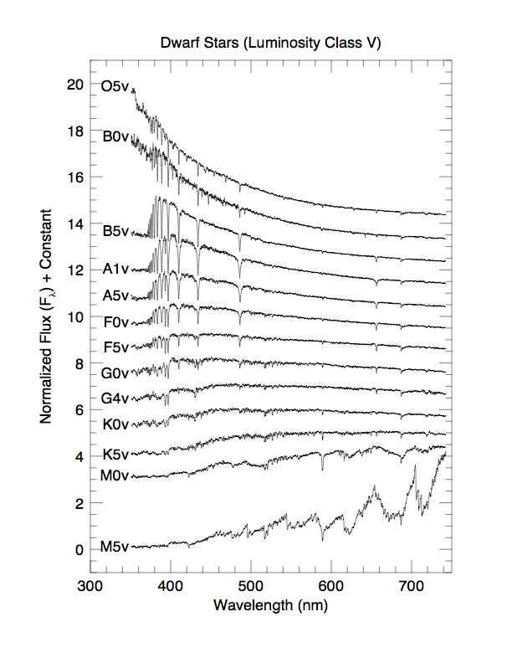
Stellar Spectra
Hε
Hδ
Hγ
Hβ
Hα
Colors:
peak in U: B-type
peak in B: F-type
peak in V: early K-type
peak in R: mid K-type
Na D
Ca⁺ K&H
TiO
Jacoby, Hunter, & Christian (1984)

Slide 15
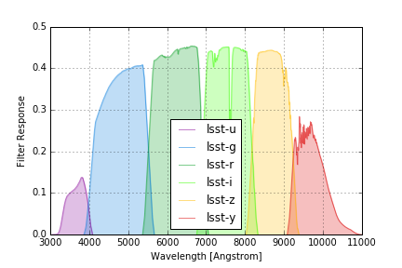
Filters
Rubin/LSST
Notes:
NAAP Labs > Blackbody Curves and UBV Filters > Light and Filters Simulator - shows action of filters

Slide 16
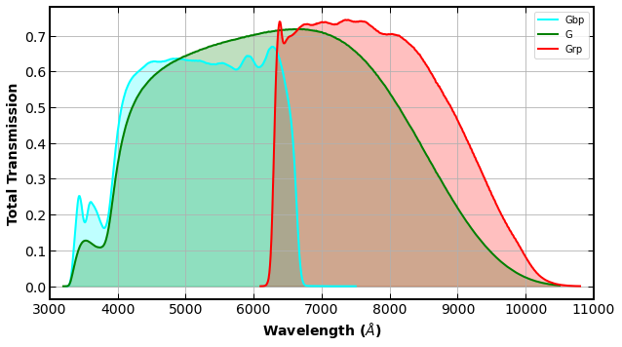
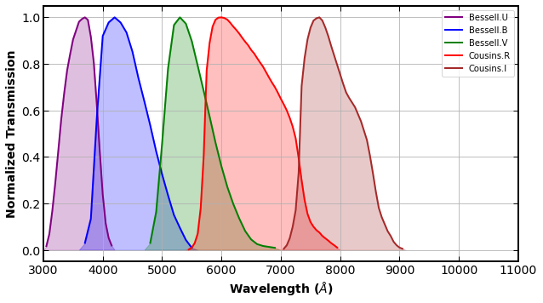
Filters
Gaia
Johnson-Cousins
Notes:
NAAP Labs > Blackbody Curves and UBV Filters > Light and Filters Simulator - shows action of filters

Slide 17


Colors
$$m_{1}−m_{2}=−2.5\log_{10}\left(\frac{F_{1}}{F_{2}}\right)$$
COLOR: compare magnitudes in different wavelength ranges for same star
➔independent of distance
$$B−V=−2.5\log_{10}\left(\frac{F_{B}}{F_{V}}\right)+C_{B}−C_{V}$$
Notes:
Derive from Vega definition

Slide 18
Thought Question
For a very hot star, what should the flux ratio F_{B}/F_{V} and the color B-V be like?
ratio < 1, color > 0
ratio < 1, color < 0
ratio > 1, color > 0
ratio > 1, color < 0
Notes:
Answer: 4 (~50% after some discussion)

Slide 19
Star Color
Measure star’s fluxes in two wavelength ranges, such as blue (“B”) and “visual” (“V” – yellow-green)
ratio of brightnesses relates to color:
hot:
cool:
→compare star’s intensity in different wavelengths:
BLUE GREEN RED
BLUE GREEN RED

Slide 20
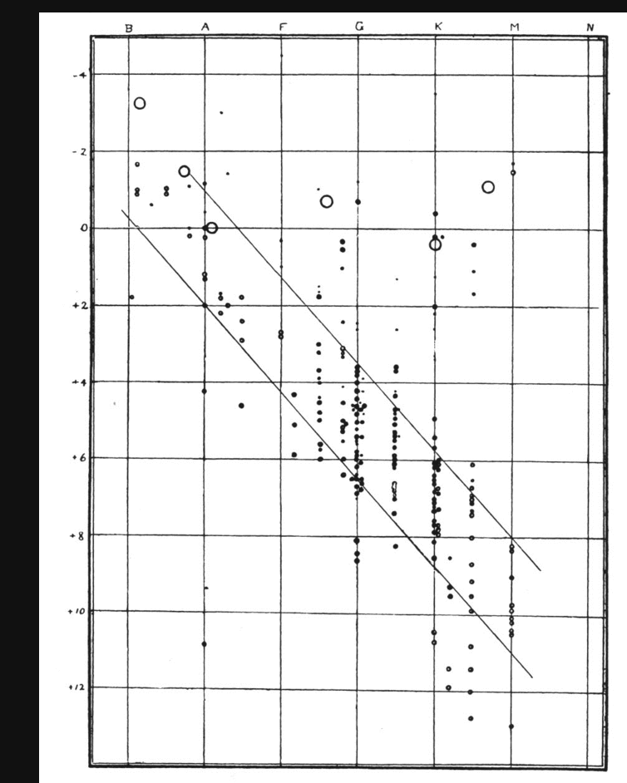
Discussion Question
Interpret this diagram:
What are on the axes, and what are the dots?
What is your primary conclusion from the graph?
Any other interesting details?
Russell (1914)
Notes:
absolute visual magnitude versus spectral type
points are stars with parallax information (size related to parallax reliability)
most stars have a relationship of abs mag and spectral type
two sequences (dwarfs and giants)
at least one white dwarf is present

Slide 21
“HR Diagram”
Spectral Type
Absolute Magnitude (visual)
There are “dwarfs” and “giants”
Russell (1914)
Notes:
absolute visual magnitude versus spectral type
points are stars with parallax information (size related to parallax reliability)
most stars have a relationship of abs mag and spectral type
two sequences (dwarfs and giants)
at least one white dwarf is present

Slide 22
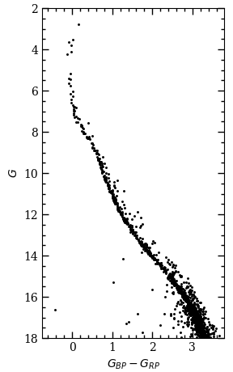
Color-Magnitude Diagram
➔most useful for stars at same distance (or corrected for distance)
Pleiades star cluster
(Gaia spacecraft data)
➔brighter/more luminous stars at top
apparent magnitude
➔filter with shortest wavelength given first (T↓ as color↑)

Slide 23
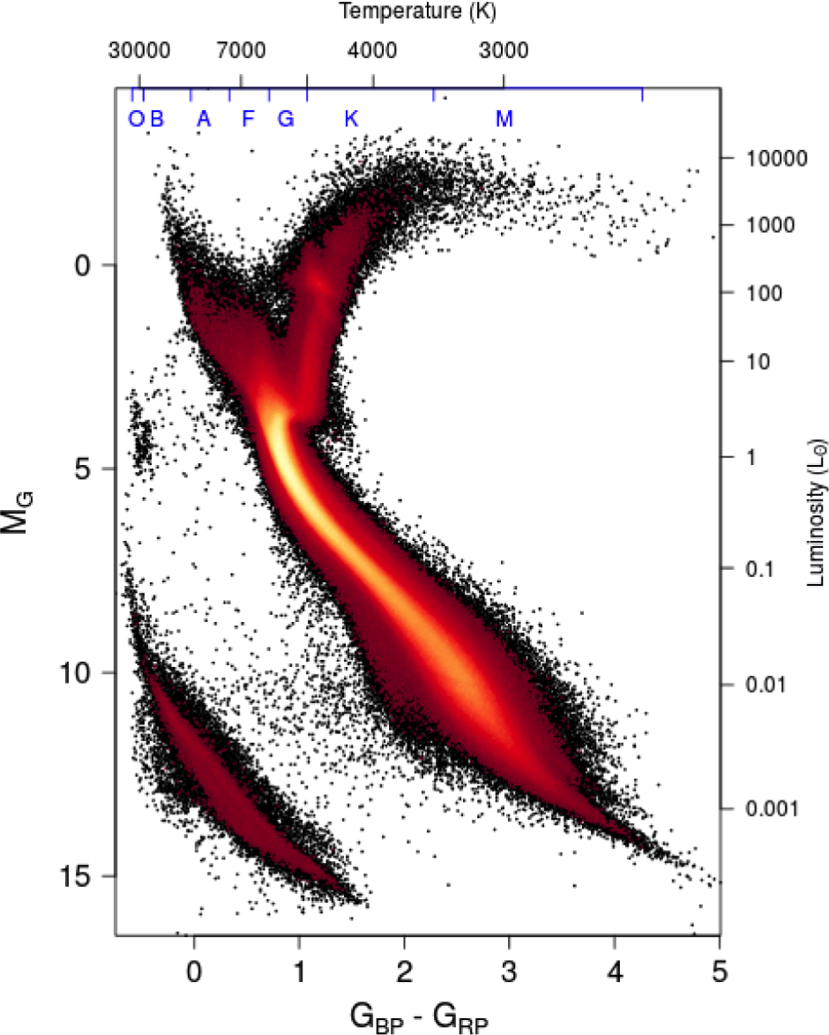
Color-Magnitude Diagram
4.27 million stars with best-measured parallaxes from Gaia
(less than 10% error)
Notes:
Gaia: 4.27 million stars
http://astro.unl.edu/classaction/animations/stellarprops/hrexplorer.html HR diagram explorer

Slide 24
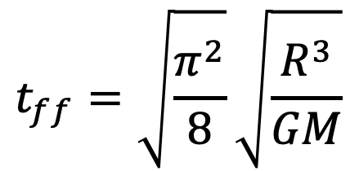
Time for Collapse?
$$t_{ff}=\sqrt{\frac{π^{2}}{8}}\sqrt{\frac{R^{3}}{GM}}$$
Notes:
Stars can easily survive free-fall timescales because of pressure forces

Slide 25
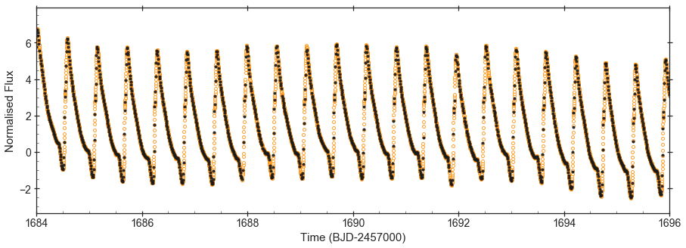
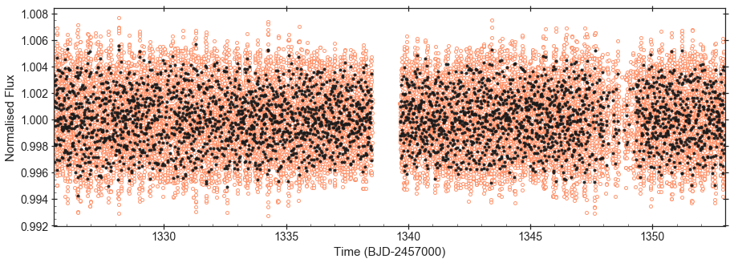
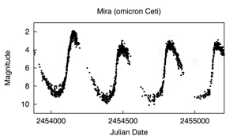
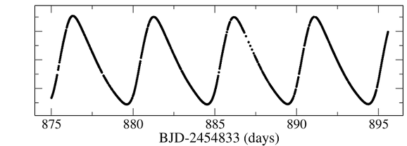
Thought Question
1) RR Lyrae
Which of the stars is likely to have the lowest average density? (All times are given in days.)
2) 𝛅 Scuti
4) Cepheid
3) Mira
Kepler mag.
Notes:
Answer: 3.

Slide 26
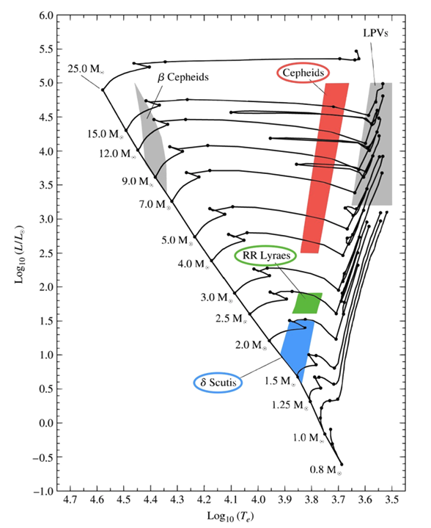
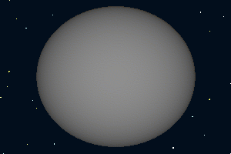
Look at the sizes:

Slide 27
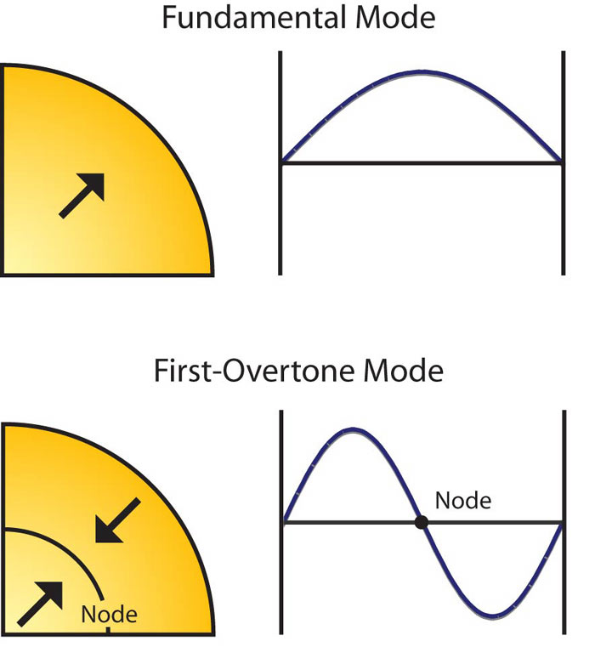
Look at the sizes:

Slide 28
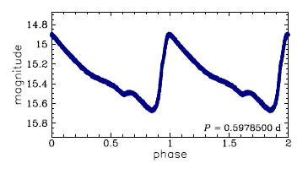
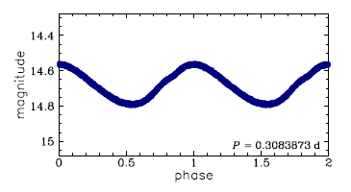
Look at the sizes:

Slide 29
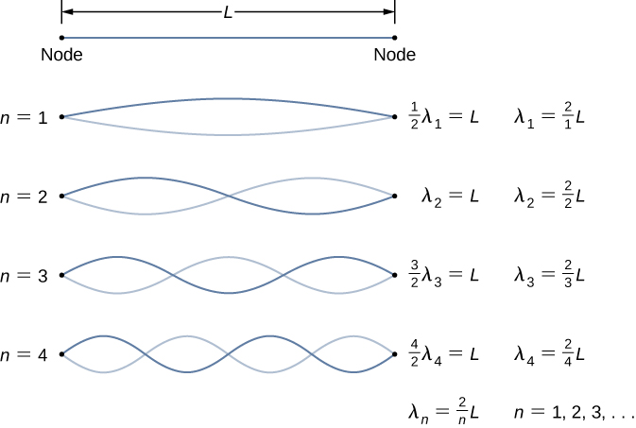
Particle-in-a-Box Solutions

Slide 30
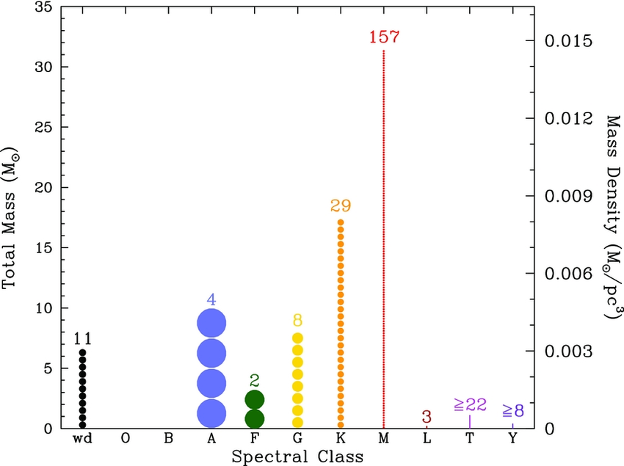
How Common?
Within 8 pc:
Notes:
if corpses, probably not coming from the K and M stars… too few

Slide 31
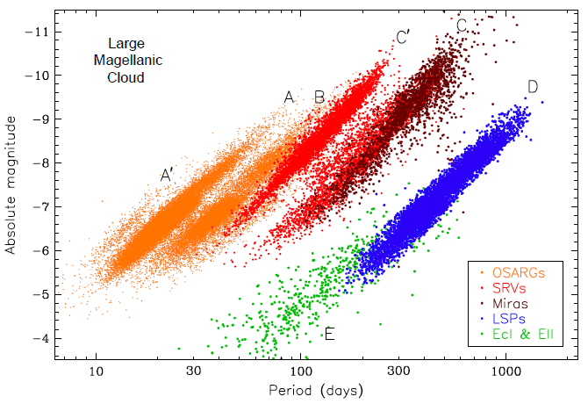
Period-Luminosity Relations
Notes:
dimensional analysis of pressure equation / dynamical timescale

Slide 32
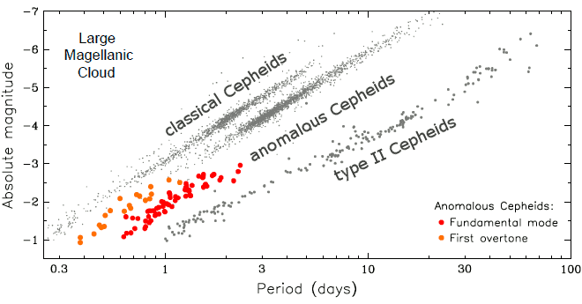
Period-Luminosity Relations
Notes:
dimensional analysis of pressure equation / dynamical timescale

Slide 33
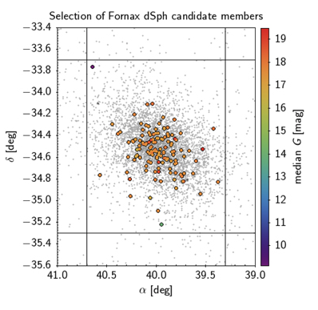
Fornax Dwarf Galaxy
Notes:
dimensional analysis of pressure equation / dynamical timescale

Slide 34
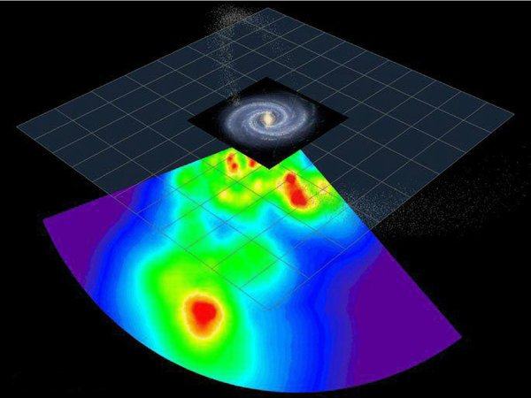
Clustering…
Notes:
dimensional analysis of pressure equation / dynamical timescale

Slide 35
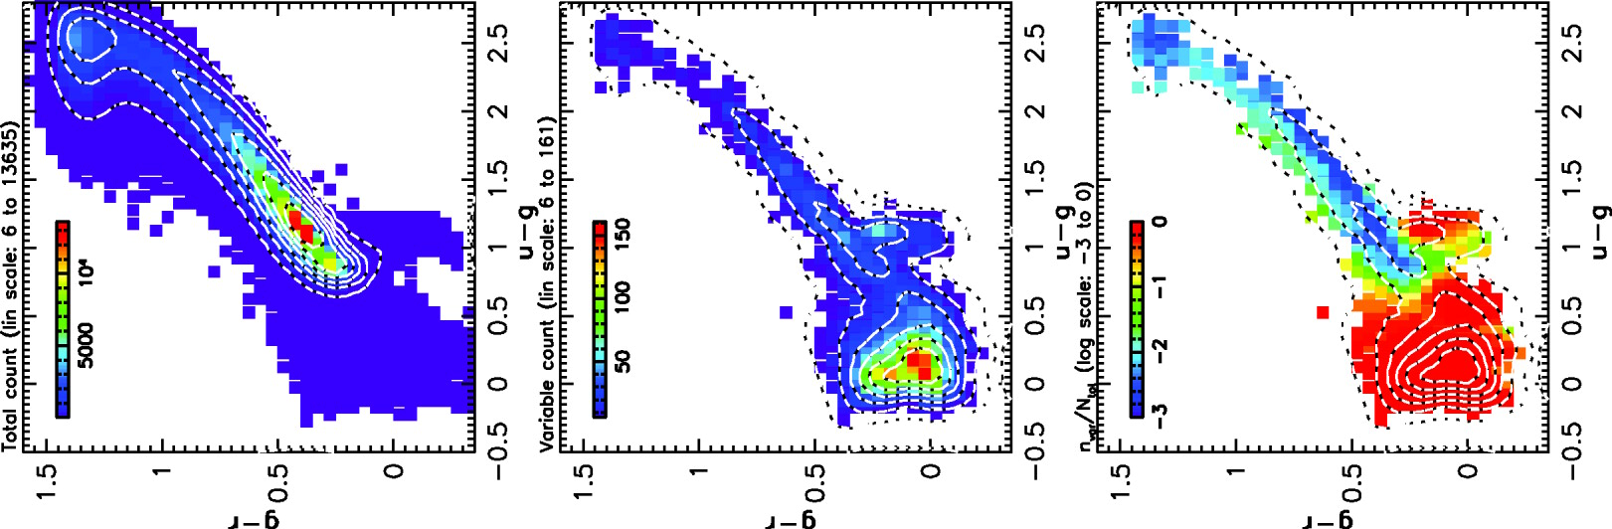
Clustering…
Notes:
dimensional analysis of pressure equation / dynamical timescale

